Slide 1
wireless access http://www.nottingham.ac.uk/is/connect/wireless/uon-guest.aspx Nottingham, 23rd April 2013
Pseudonymisation workshop

Slide 2
My roles
Academic
NHS GP
Co-Director QResearch database with Shaun O’Hanlon from EMIS
Director ClinRisk Ltd
Member of Confidentiality Advisory Group, HRA

Slide 3
Introductions
Introduce ourselves
Our organisation
What do we want to get from the meeting

Slide 4
Key objectives for safe data sharing
Maximise public benefit
Patient and their data
Minimise risk
Privacy
Maintain public trust

Slide 5
Three main options for data access
Maximise public benefit
Pseudo
nymisation
consent
Patient and their data
Minimise risk
Privacy
Maintain public trust
S251
statute

Slide 6
Policy context
Transparency Agenda
Open Data
Caldicott2
Benefits of linkage for (in order from document)
Industry
Research
commissioners
Patients
service users
public

Slide 7
Objectives
Open common technical approach for pseudonymisation
allows individual record linkage BETWEEN organisations
WITHOUT disclosure strong identifiers
Inter-operability
Voluntary ‘industry’ specification
One of many approaches

Slide 8
Ground rules: all outputs from workshop
Published
Open
Freely available
Can be adapted & developed
Complement existing approaches

Slide 9
Big Data or Big Headache
Need to protect patient confidentiality
Maintain public trust
Data protection
Freedom of Information
Information Governance
‘safe de-identified format’

Slide 10
Assumptions for today
Pseudonymisation is desired “end state” for data sharing for purposes other than direct care
Legitimate use of data
legitimate purpose
legitimate applicant or organisation
Ethics and governance approval in place
Appropriate data sharing agreements

Slide 11
Working definition of pseudonymisation for today
Technical process applied to identifiers which replaces them with pseudonyms
Enables us to distinguish between individual without enabling that individual identified
Either reversible or reversible
Part of de-identification

Slide 12
Identifiable information
person identifier that will ordinarily identify a person:
Name
Address
Dob
Postcode
NHS number
telephone no
Email
(local GP practice or trust number)

Slide 13
Open pseudonymiser approach
Need approach which doesn’t extract identifiable data but still allows linkage
Legal ethical and NIGB approvals
Secure, Scalable
Reliable, Affordable
Generates ID which are Unique to project
Can be used by any set of organisations wishing to share data
Pseudonymisation applied as close as possible to identifiable data ie within clinical systems

Slide 14
Pseudonymisation: method
Scrambles NHS number BEFORE extraction from clinical system
Takes NHS number + project specific encrypted ‘salt code’
One way hashing algorithm (SHA2-256) – no collisions and US standard from 2010
Applied twice - before leaving clinical system & on receipt by next organisation
Apply identical software to second dataset
Allows two pseudonymised datasets to be linked
Cant be reversed engineered

Slide 15
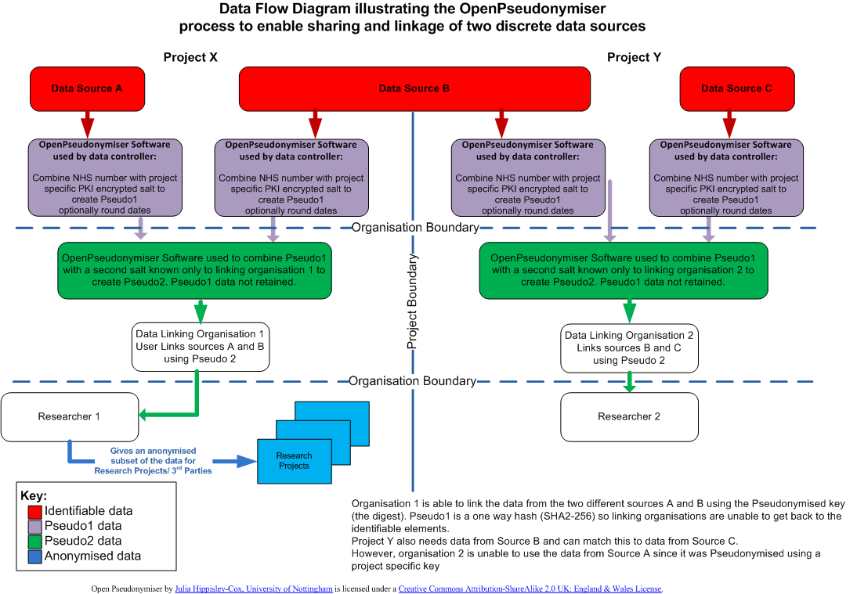

Slide 16
Web tool to create encrypted salt: proof of concept
Web site private key used to encrypt user defined project specific salt
Encrypted salt distributed to relevant data supplier with identifiable data
Public key in supplier’s software to decrypt salt at run time and concatenate to NHS number (or equivalent)
Hash then applied
Resulting ID then unique to patient within project

Slide 17
Openpseudonymiser.org
Website for evaluation and testing with
Desktop application
DLL for integration
Test data
Documentation
Utility to generate encrypted salt codes
Source code GNU LGPL

Slide 18
Key points
Pseudonymisation at source
Instead of extracting identifiers and storing lookup tables/keys centrally, then technology to generate key is stored within the clinical systems
Use of project specific encrypted salted hash ensures secure sets of ID unique to project
Full control of data controller
Can work in addition to existing approaches
Open source technology so transparent & free

Slide 19
Qresearch data linkage projects
Link HES, Cancer, deaths to QResearch
NHS number complete and valid in > 99.7%
Successfully applied OpenP
- Information Centre
- ONS cancer data
- ONS mortality data
- GP data (EMIS systems)

Slide 21
QAdmissions
New risk stratification tool to identify risk emergency admission
Modelled using GP-HES-ONS linked data
Can apply to linked data or GP data only
NHS number complete & valid 99.8%
97% of dead patient have matching ONS deaths record
High concordance of year of birth, deprivation scores

